Slide 1
Running SU2
Pointwise® and SU2 Joint Workshop
Sept 29th-30th, 2014
Heather Kline, Andrew Wendorff
Aeronautics & Astronautics Department (Stanford University)

Slide 2
What do I need to run a simulation?
Test case definition
Interactive session
Questions?

Slide 3
Running Simulations with SU²
What do I need to run simulations with SU2?
Configuration file (.cfg)
Mesh file (.su2 or .cgns)
This session will use:
Lam_NACA0012.cfg
Mesh_NACA0012_lam_omesh.su2

Slide 4
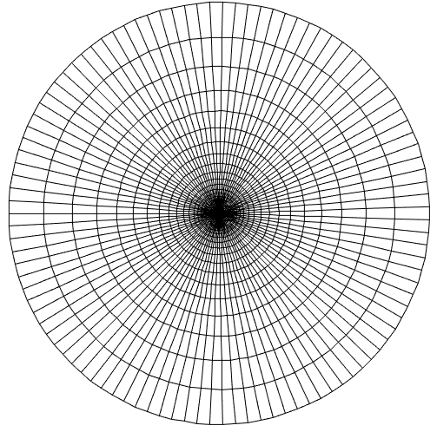
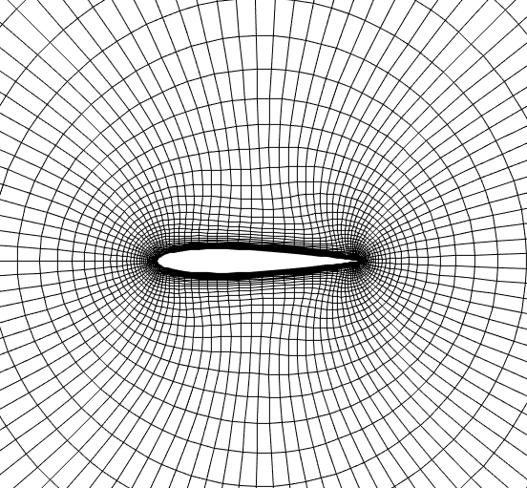
Quick Start Tutorial NACA 0012 Airfoil
Transonic, Euler flow
Mach No. = 0.5
Pressure = 101,325 Nm-2
Temperature = 288.15K
Angle of attack = 1.0º
Reynolds number = 1,000

Slide 5
Flow Solution
Config options:
Most parameters have default values
The order of config options is not important
PHYSICAL_PROBLEM= NAVIER_STOKES
%
MATH_PROBLEM= DIRECT
%
MACH_NUMBER= 0.5
%
AoA= 1.00
%
REYNOLDS_NUMBER=1000.0
%
FREESTREAM_TEMPERATURE= 288.15
%
MESH_FILENAME= mesh_NACA0012_lam_omesh.su2

Slide 6
Restart
Simulations can be restarted from partially converged results
Config options:
RESTART_SOL= NO
%
EXT_ITER= 999999
RESTART_SOL= YES
%
SOLUTION_FLOW_FILENAME= solution_flow.dat

Slide 7
Solver Parameters
Among the many options in the config file, various parameters exist to modify the solution method
Config options:
RESTART_SOL= NO
%
CFL_NUMBER= 4.0
%
CFL_RAMP= ( 1.1, 10, 10.0 )
%
CONV_NUM_METHOD_FLOW= ROE
%
SPATIAL_ORDER_FLOW= 2ND_ORDER

Slide 8
Interactive
Direct Solution demonstration
Materials:
https://github.com/su2code/Documentation/tree/master/QuickStart_NS/
Lam_NACA0012.cfg, mesh_NACA0012_lam_omesh.su2
Notes:
Budgeted time: 10 minutes

Slide 9
Adjoint Solution
Sensitivity of a functional to changes in the flow
e.g., How does changing the airfoil shape affect drag?
Additional required file:
Converged flow solution
Config options:
MATH_PROBLEM= ADJOINT
%
RESTART_SOL= NO
%
OBJECTIVE_FUNCTION= DRAG
%
SOLUTION_FLOW_FILENAME= solution_flow.dat
Notes:
Change restart_flow.dat to solution_flow.dat
Copy config file, change settings

Slide 10
Interactive
Adjoint Solution Demonstration
Notes:
Start : won’t finish in time, go to example results

Slide 11
Additional Resources
Online documentation
http://su2.stanford.edu
Online tutorials
su2.stanford.edu > Training
also accessible via su2.stanford.edu > Guides > User’s Tutorials
TestCases directory
github.com/su2code/TestCases/
CFD Online forum
http://www.cfd-online.com/Forums/su2/

Slide 12
Questions?

Slide 13
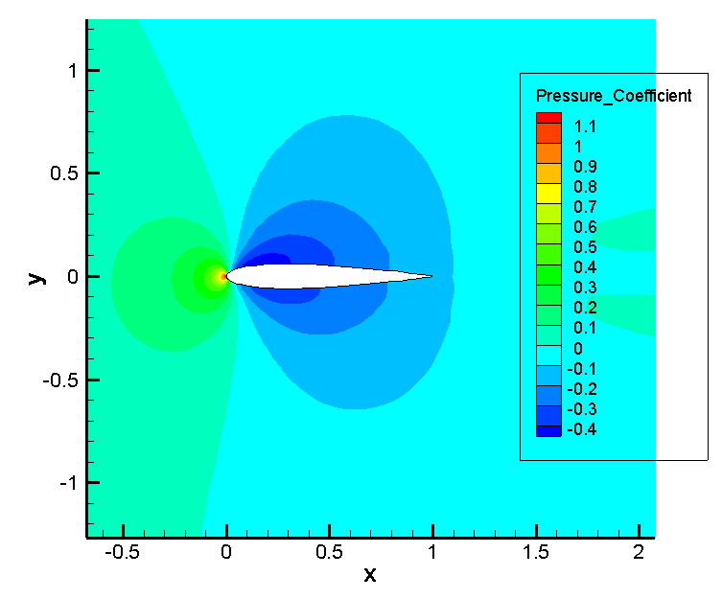
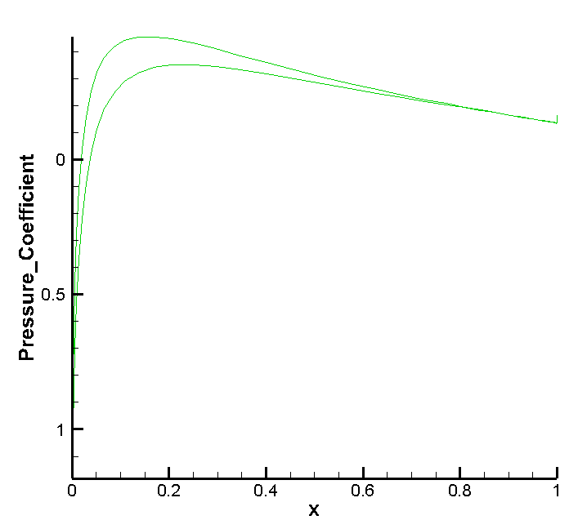
Results: Direct Solution

Slide 14
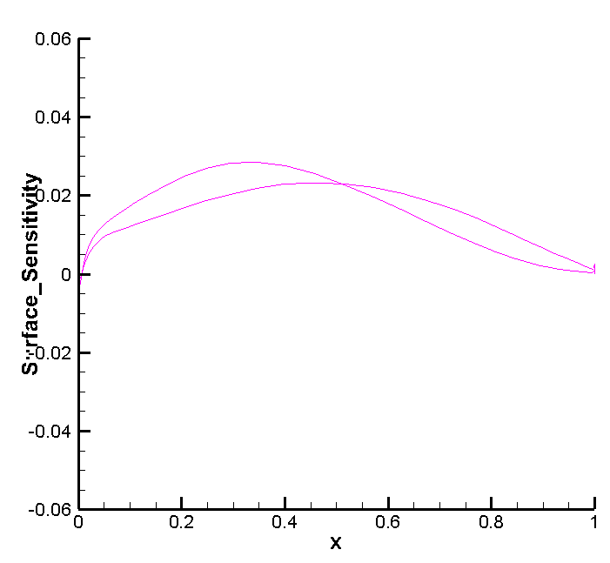
Results: Adjoint Solution

